Slide 1
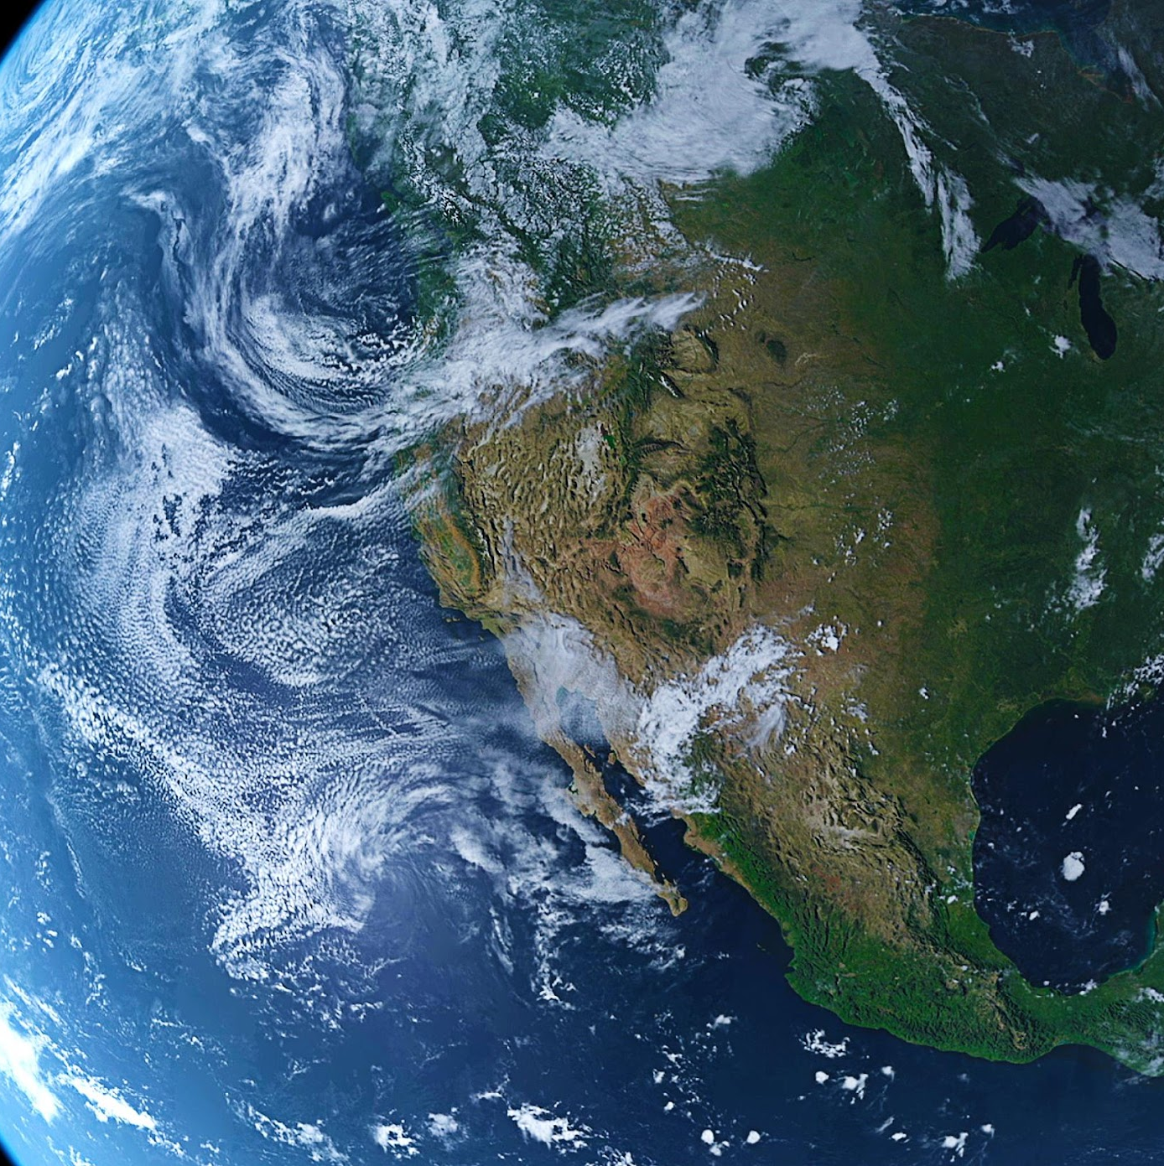
Weather Conditions and Climate Change with Machine Learning
An overview of machine learning tools and analysis for ClimateWins
By Ron Baron
03/24/2025

Slide 2
Overview
Objective and Background
Hypotheses
Data
Data Optimization
Supervised Machine Learning Models
Summary

Slide 3

Objective Leverage machine learning to help predict the consequences of climate change.

Slide 4
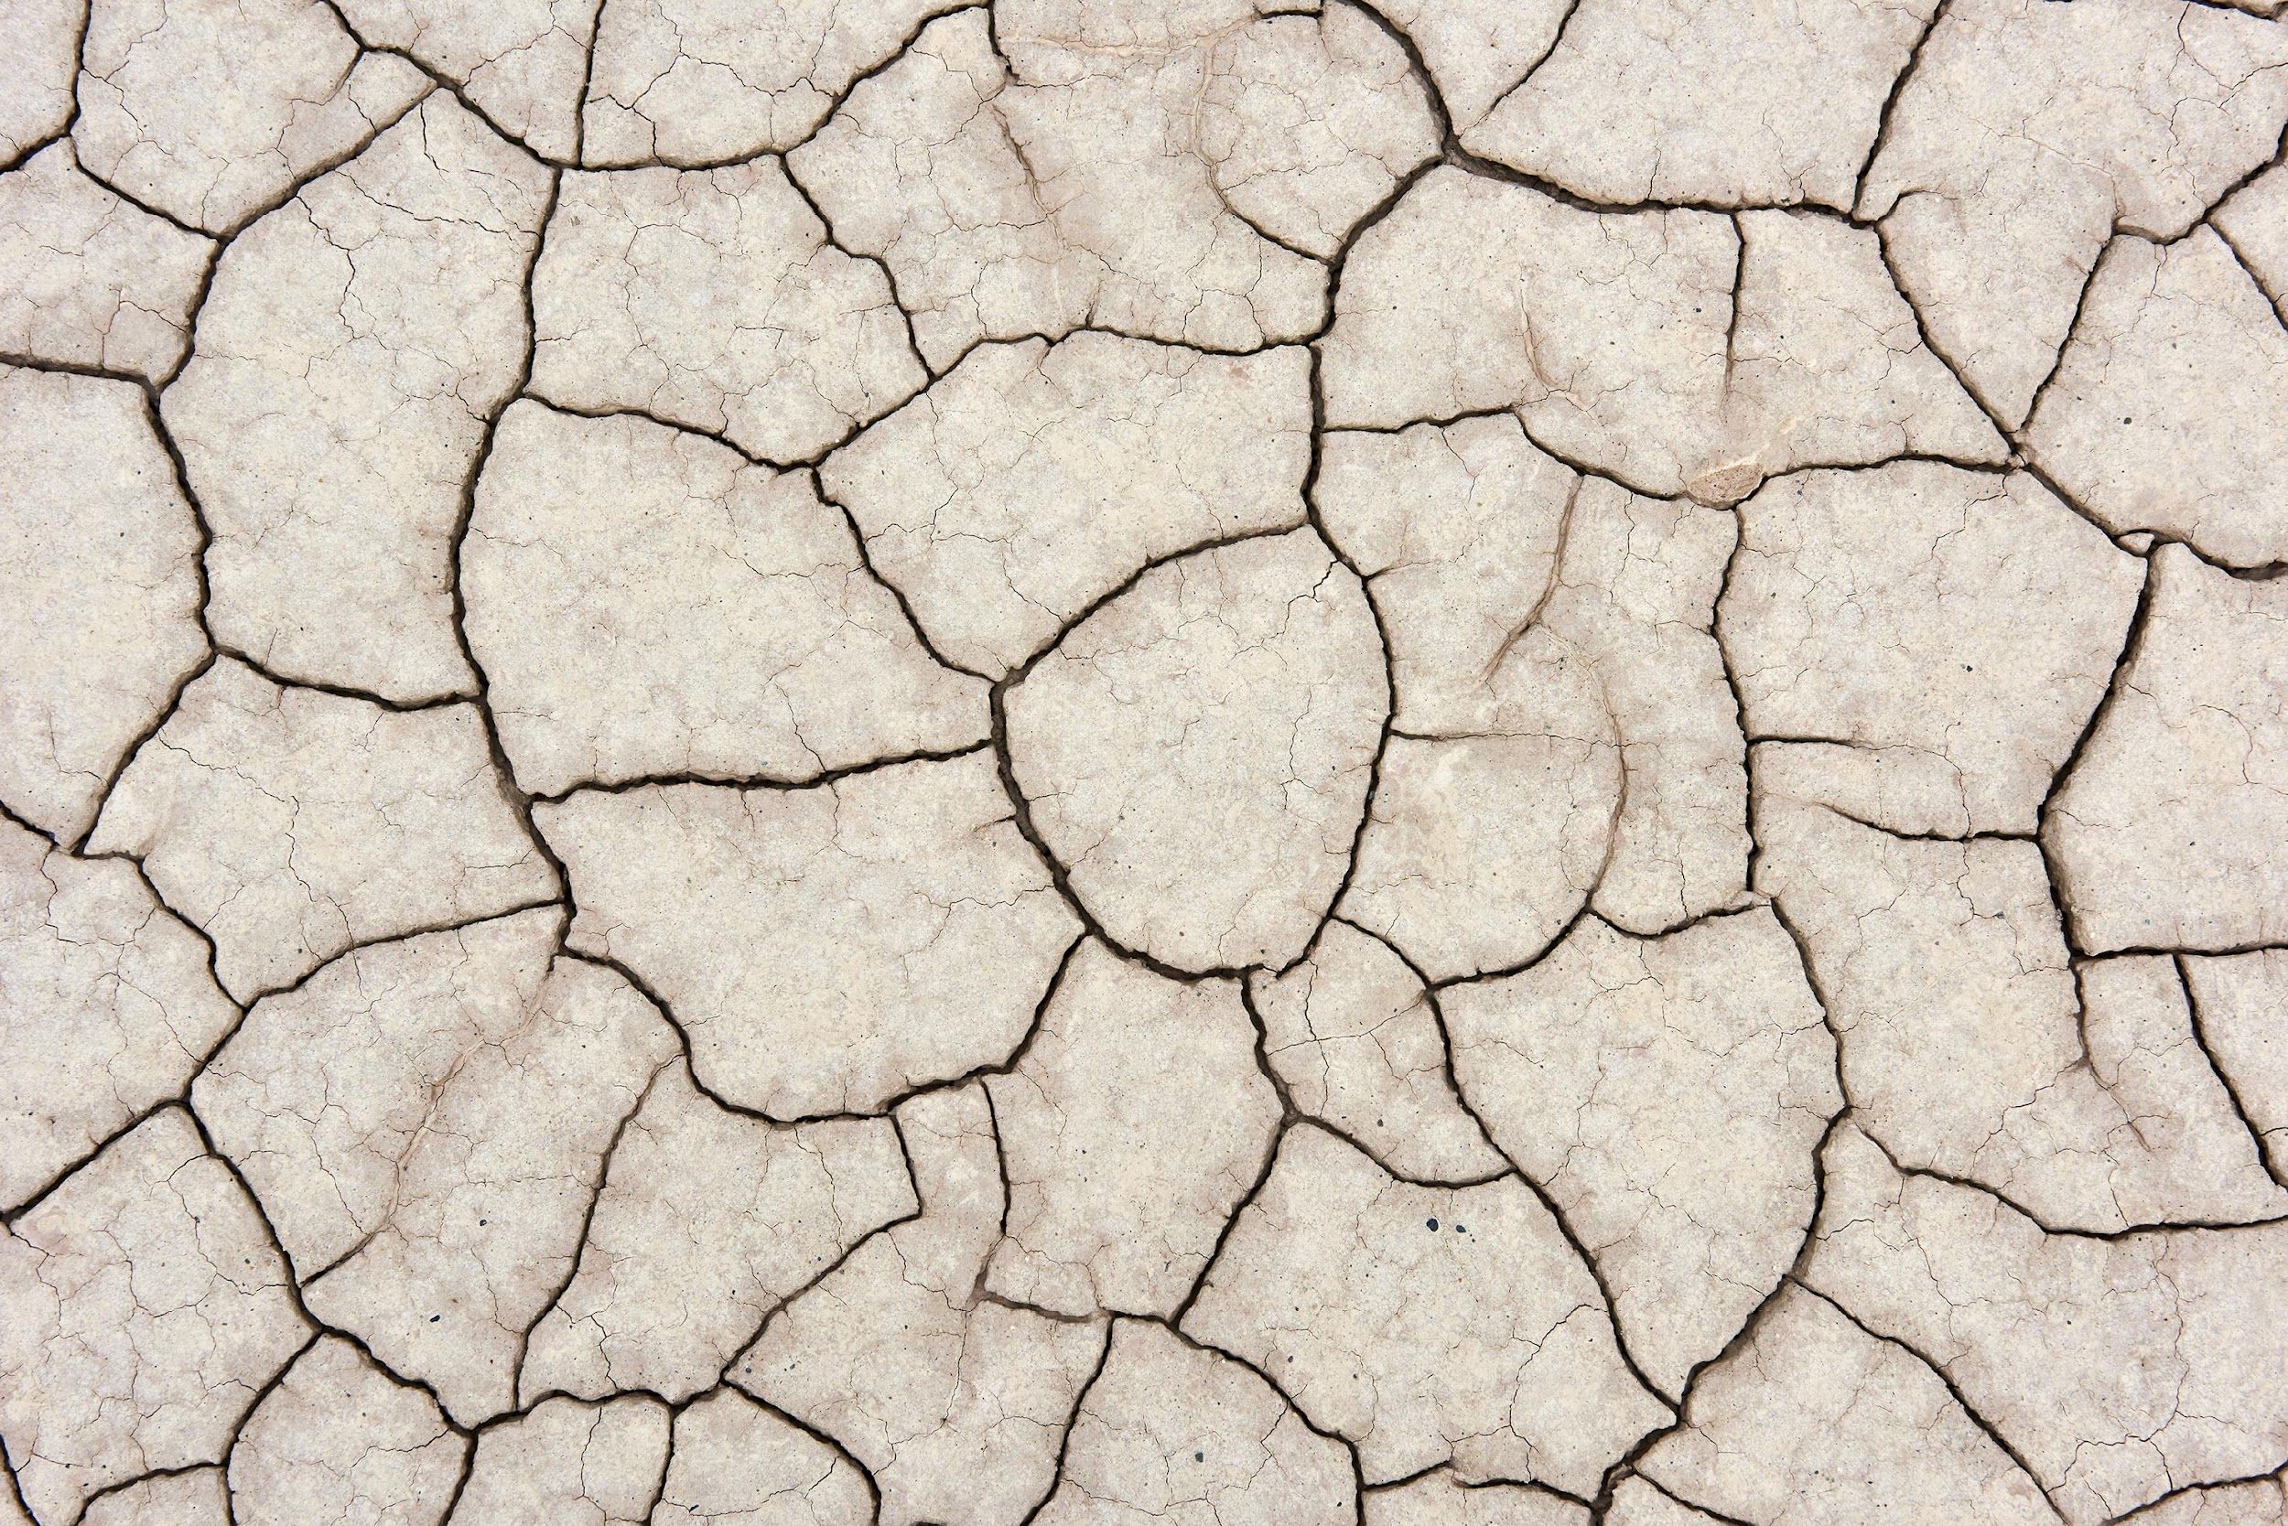
Extreme Weather
The past 10 to 20 years have shown an increase in extreme weather events in mainland Europe.
With proper tools like advanced machine learning, it may be possible to predict these events before they occur and create a model for the future that can help predict the consequences of climate change globally.
Countries and societies can be better prepared to prevent and respond to the consequences of extreme weather events.

Slide 5
Hypotheses
Prediction accuracy will depend on climate conditions and geographic location.
Machine learning algorithms will consistently and accurately predict future weather conditions.
One machine algorithm will surpass another in terms of prediction efficacy and accuracy.

Slide 6
Data
Hurricane predictions from The National Oceanic and Atmospheric Administration (NOAA) in the U.S., typhoon data from The Japan Meteorological Agency (JMA) in Japan, world temperatures, and a great deal of other data.
Data set based on weather observations from 18 different weather stations across Europe, which contain data ranging from the late 1800s to 2022. Recordings exist for almost every day with values such as temperature, wind speed, snow, global radiation, and more. Data is collected by the European Climate Assessment & Data Set project.
It’s hard to grasp how everything is changing in the world at once. This is where machine learning comes in.

Slide 7
What about bias?
Spatial bias: The dataset only covers 18 stations across Europe, which is a small sample compared to the entire continent's vast area and diverse climates. This means that the data might not accurately represent weather patterns in areas outside of the station locations.
Selection bias: data is only from 18 stations in Europe and likely is not a comprehensive sample, risking the exclusion or underrepresentation of certain areas.
Quality bias: The accuracy of the data can be affected by instrument errors and human errors.
Temporal bias: Some stations might have been operational for a shorter time than others, leading to uneven temporal coverage. There might be periods with missing data, which could create gaps in the long-term record and affect trends analysis.

Slide 8
Data Optimization

Slide 9

Gradient Descent
The data was optimized through Gradient Descent on the average temperatures of several weather stations.
Gradient descent is an iterative optimization algorithm used in machine learning.
It was applied to find the minimum error, through number of iterations, as well as the number of steps.
Notes:
to find the minimum of a function, often used to train machine learning models by minimizing the cost function and reducing the difference between predicted and actual results.

Slide 10
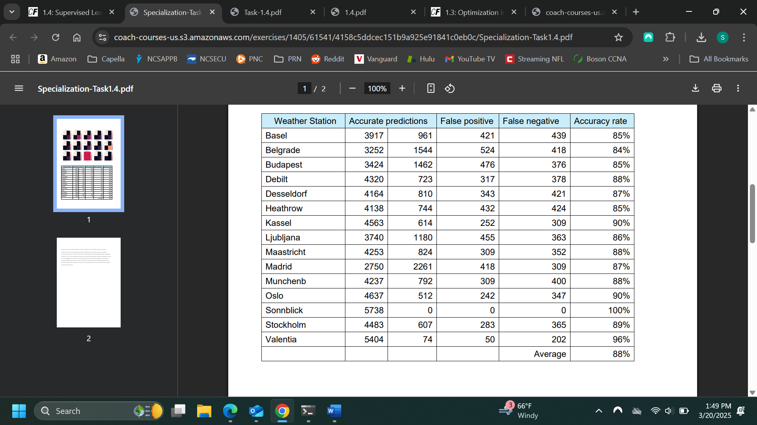
K-Nearest Neighbor
K-nearest neighbor algorithm(KNN) makes predictions by calculating the distance between new data points, or neighbors, after which nearby data points are grouped based on the number of neighbors in each group.
Pleasant weather days were predicted using KNN in Europe yielding an average accuracy of 88%.
Sonnblick shows 100% accuracy for unpleasant weather, indiciating that the model is overfitting, or that the algorithm fits too closely to its training data and has difficulty generalizing to other data.
A more accurate model will learn from varied data and face more diverse weather conditions and geographical locations.
Sonnblick’s 100% accuracy rate indicate there are zero pleasant weather days in Sonnblick.

Slide 11
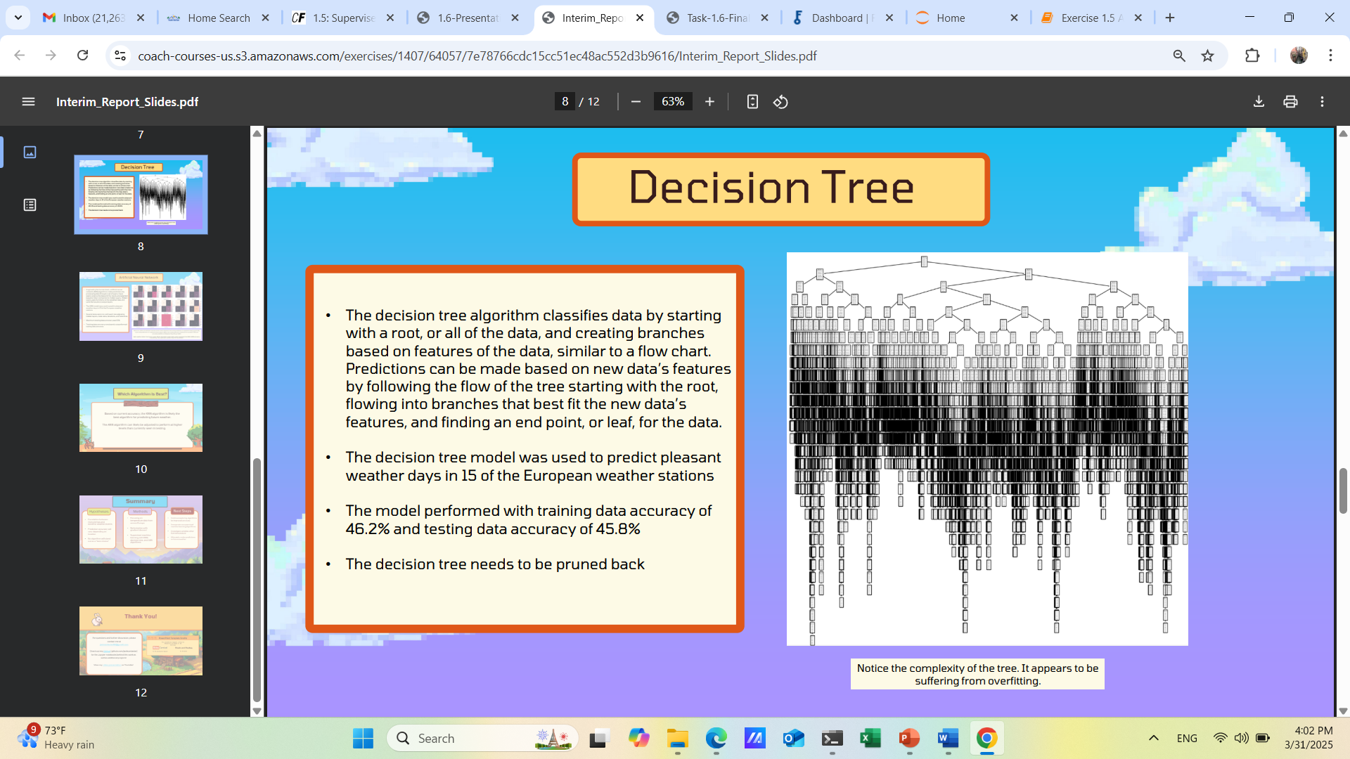
Decision Tree
Makes predictions by answering a series of questions about the features of the data.
Consists of nodes and branches where new data points follow the flow of the tree based on its best fit.
Model was used to predict pleasant weather days in 15 of the European weather stations.
Complex with too many branches making it difficult to interpret the model.
Large, which can mean lengthy training time.

Slide 12
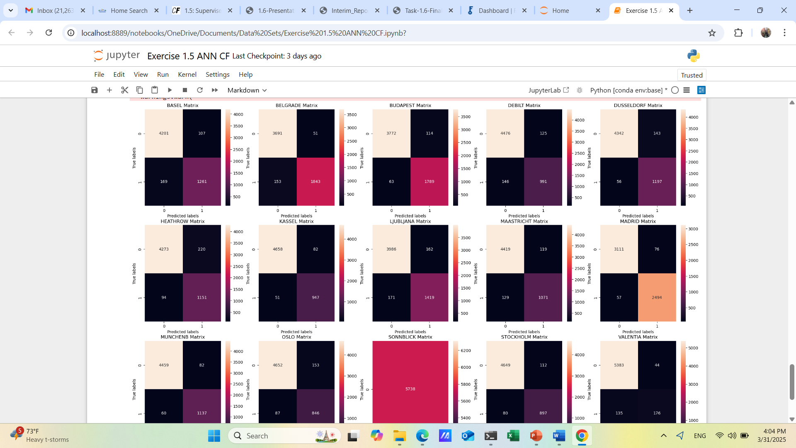
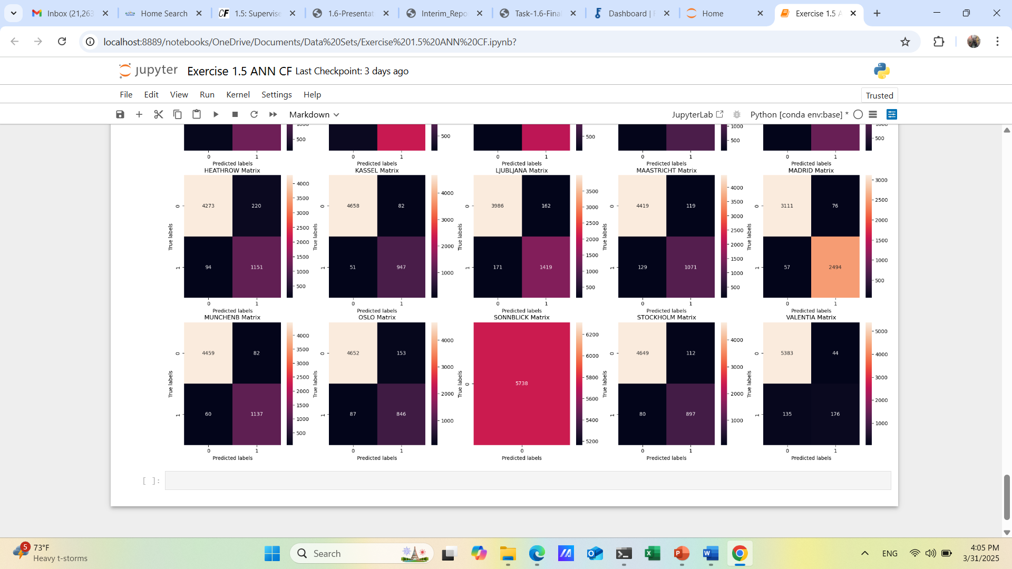
Artificial Neural Network
Artificial Neural Network (ANN) is a computer model that emulates the way the human brain processes information.
Input layers, or “neurons,” are interconnected and learn patterns from data through training.
Used to predict pleasant weather days in 15 of the European weather stations.
By adjusting connections between neurons, it improves its ability to make predictions or classifications.
Training data accuracy outperformed testing data accuracy.
Best accuracy was 64%.

Slide 13
Most Preferred Algorithm?
ANN model is the recommended choice for weather predictions.
The decision tree model is too complex to interpret.
KNN model provides the highest accuracy with an average of 88% across all weather stations vs. an average of 60% with ANN.
Even though it necessitates more manual input and manipulation, ANN is suitable for complex patterns and data and learns from historical data, after which it can make a prediction with a higher accuracy rate.
The weather data is complex and nonlinear, and the ANN model is more scalable for larger datasets and less sensitive to noise.

Slide 14
Summary
Hypotheses | Methods |  | Next Steps
Prediction accuracy varies based on geographic location and various climate conditions within the region. | Temperature data across Europe |  | Improve accuracy of ANN algorithm.
Machine learning algorithms can accurately predict future weather conditions with some models with accuracy up to 88% | Optimization with Gradient Descent |  | Incorporate unsupervised machine learning algorithms and examine other variables aside from temperature.
Algorithms can surpass one another in terms of accuracy, but a nuanced approach is needed to understand the prediction rates and learning design of the model. | Supervised machine learning with KNN, Decision tree, and ANN algorithms. |  | Use the algorithm to make weather predictions for ClimateWins.

Slide 15
Thank you!
For questions or comments, please contact me at ronbabaron7@gmail.com or check out more of my work at my github, ronebenor · GitHub

